Slide 1
Bangladesh University of Engineering and Technology
Department of Biomedical Engineering
Course No- BME 205
MECHANICAL VENTILATOR
Presented By:
Group – 4
1718016
1718017
1718018
1718019
1718020

Slide 2
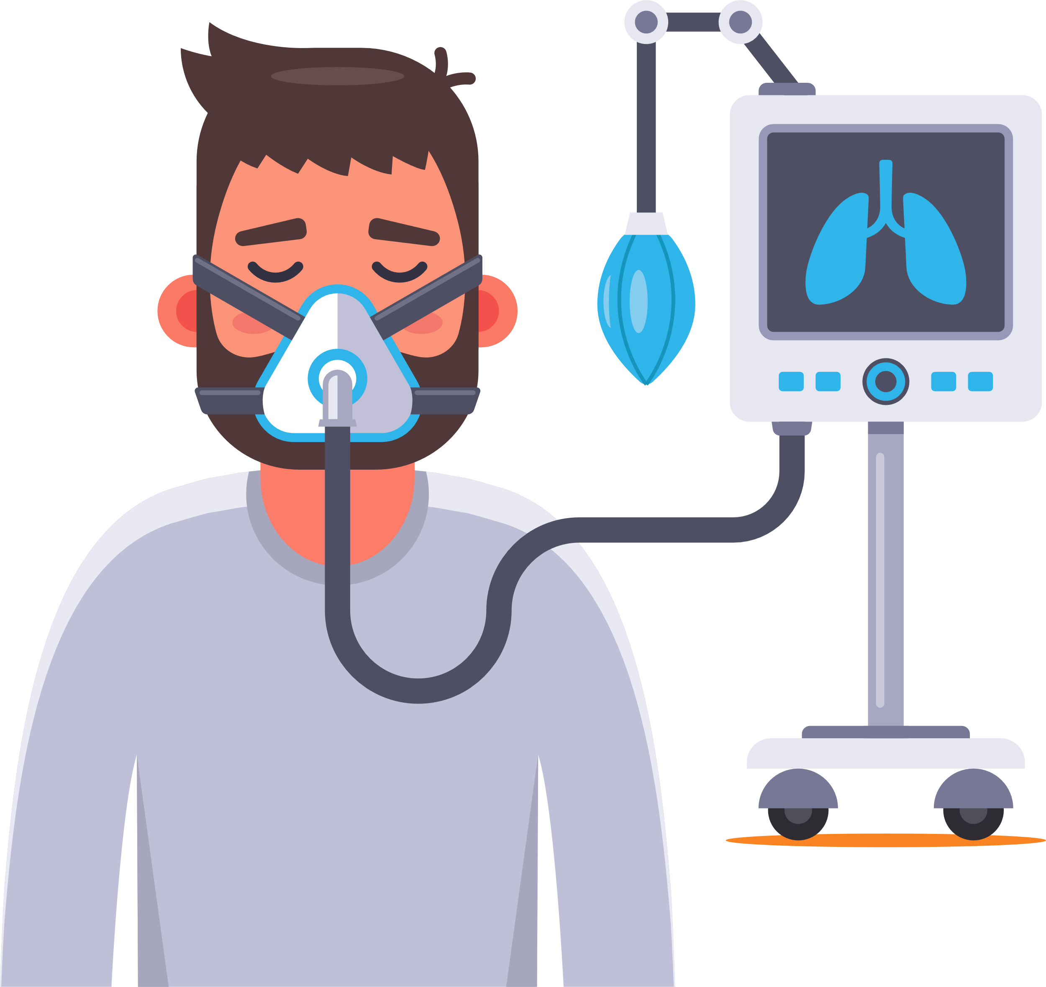
What is a ventilator
MECHANICAL VENTILATOR
Overview:
1.Definition
2.Physiology
3.Usage
4.Components
5.Mechanism
6.Applications of fluid mechanics
6.Problems and Solution
7.Q&A

Slide 3
What is a ventilator
Machine that helps people breathe when they can't breathe on their own
Helps to move oxygen into the lung and CO₂ out of the lung by using a pressure.

Slide 4
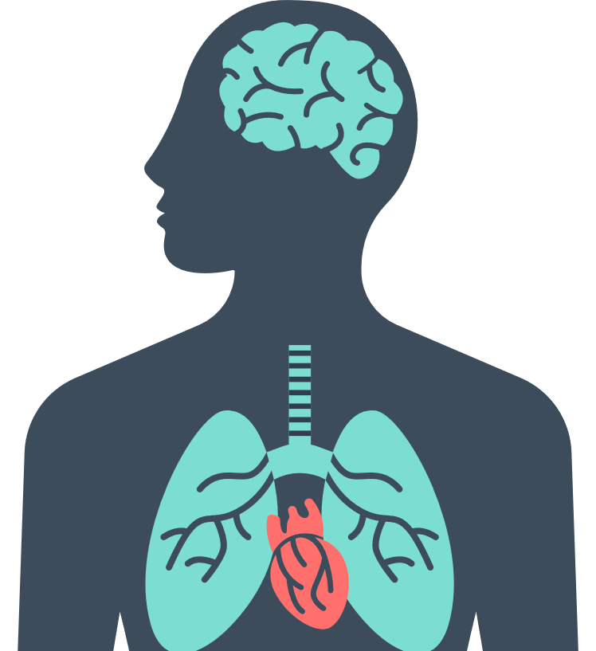

Slide 5
O₂

Slide 7
CO₂

Slide 8
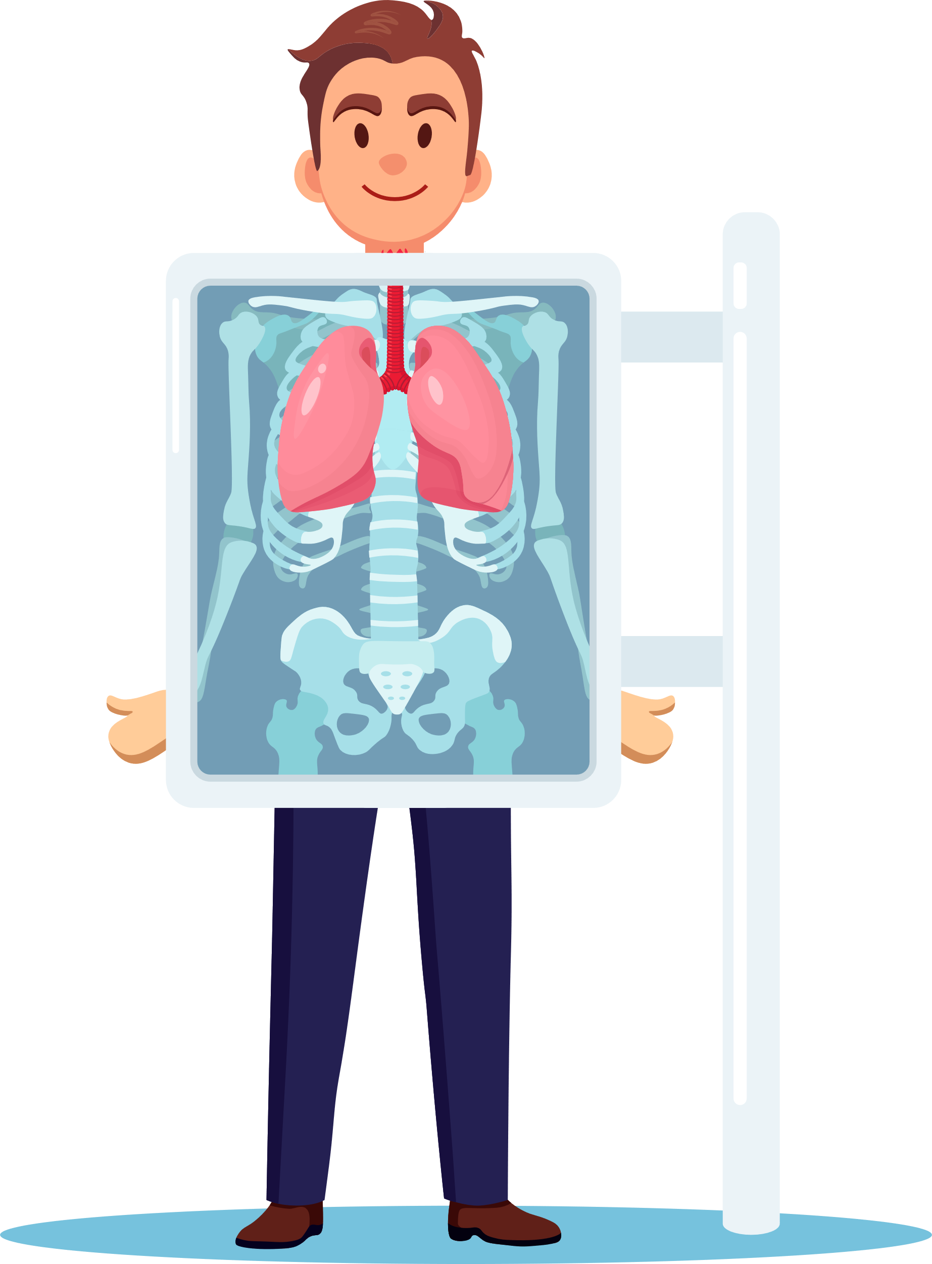
LUNG PHYSIOLOGY

Slide 9
LUNG PHYSIOLOGY

Slide 10
Lung

Slide 12
Right Lung (3 lobes)
Left Lung (2 lobes)

Slide 13
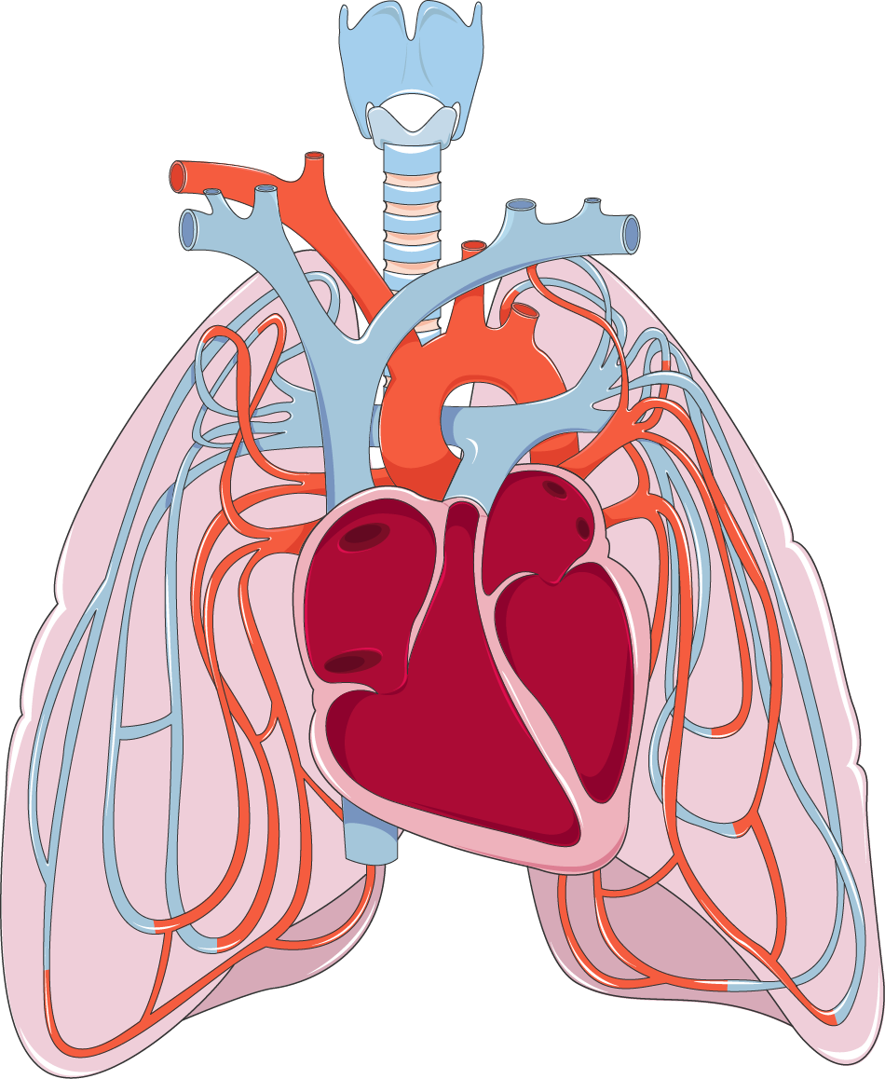

Pulmonary Blood Flow
Dexygenated Blood
Oxygenated Blood
The respiratory system is fed by
two separate blood circulation:
1.The Pulmonary Circulation(Lower P)
which supply blood flow to the alveoli
foe gas exchange.
2. The bronchial Circulation(Higher P)
which supply blood flow to the bronch
eal system

Slide 14
Pulmonary Artery
Pulmonary Vein
Alveolus
Capillaries

Slide 15
Dexygenated Blood
Oxygenated Blood
Blood Vessel
Alveolus
Blood Vessel

Slide 16
O₂
Dexygenated Blood
Oxygenated Blood
CO₂

Slide 17
Dexygenated Blood
Oxygenated Blood
O₂
CO₂

Slide 18
Dexygenated Blood
Oxygenated Blood
CO₂
O₂

Slide 19
Dead
Space
6000 ml
5000 ml
4000 ml
EXPIRATION - LUNG VOLUME - INSPIRATION
3000 ml
Tidal
Volume
(500 mL)
2000 ml
1000 ml
Tidal Volume – The amount of air entering and
leaving the lungs during normal breathing

Slide 20
Dead
Space
6000 ml
5000 ml
4000 ml
EXPIRATION - LUNG VOLUME - INSPIRATION
3000 ml
Inspiratory
Reserve
Volume
(3000 mL)
2000 ml
1000 ml
Inspiratory Reserve Volume –Extra volume of air that the patient
Can inhale with maximum effort.

Slide 21
Dead
Space
6000 ml
5000 ml
4000 ml
EXPIRATION - LUNG VOLUME - INSPIRATION
3000 ml
2000 ml
Expiratory
Reserve
Volume
(1500 mL)
1000 ml
Expiratory Reserve Volume –Extra volume of air that the patient
Can exhale with maximum effort.

Slide 22
Dead
Space
6000 ml
5000 ml
4000 ml
EXPIRATION - LUNG VOLUME - INSPIRATION
3000 ml
Residual
Volume
(1800 mL)
2000 ml
1000 ml
Residual Volume – Remained air volume in the lings after expiraion

Slide 23
6000 ml
5000 ml
Total Lung Capacity (TLC) –
Summation of all volumes
4000 ml
EXPIRATION - LUNG VOLUME - INSPIRATION
3000 ml
2000 ml
1000 ml

Slide 24
6000 ml
5000 ml
Inspiratory Capacity (IC) – IRV+TV
4000 ml
EXPIRATION - LUNG VOLUME - INSPIRATION
3000 ml
2000 ml
1000 ml

Slide 25
What is a ventilator
6000 ml
5000 ml
Vital Capacity (VC) – IRV+TV+ERV
4000 ml
EXPIRATION - LUNG VOLUME - INSPIRATION
3000 ml
2000 ml
1000 ml

Slide 26
During Surgery
surgery with general anesthesia
The medicines used for anesthesia can affect normal breathing
ventilator helps control for breathing.
Diseases
Brain injury
Lung infection
Pneumonia
Asthma
Stroke
Coma or loss ofconsciousness
Collapsed lung
Usage of ventilator
Recovering from surgery
Helps to breathe for hours or even days after surgery
In babies
Premature lung development

Slide 27





Working Principle
Covid19 and ventilators
Components of Ventilator
Gas supply(O2 and air)
1.
2.
Humidifier
3.
Inspiratory Valve
Travel to the lungs
and cause a
potentially fatal
condition called
acute respiratory
distress
syndrome (ARDS)
4.
Expiratory Valve
When a virus enters
and the body’s
immune system
does not fight off
the infection
Alveolar collapse
Less oxygen
enters into blood
Fluid enters
into alveolar sac
Ventilator helps to
maintain this
imbalance
5.
Breathing Circuit
6.
Airway

Slide 28
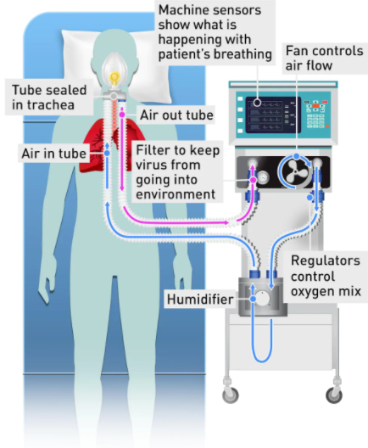
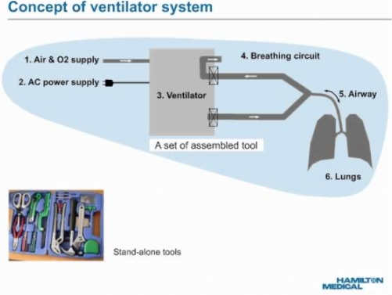
Components of Ventilator
1.
Gas supply(O2 and air)
2.
Humidifier
3.
Inspiratory Valve
4.
Expiratory Valve
5.
Breathing Circuit
6.
Airway
Fig: Basic diagram of ventilator

Slide 29
Ventilation Process
1
Inspiratory valve opens and expiratory valve closes
2
Circuit creates a positive pressure(pressure gradient)
3
Air and O2 move to humidifier
4
Then go to Lung by trachea(windpipe)
5
Lung expand and amount of O2 controlled
by monitor
6
Inspiratory valve closes and expiratory valve
opens
7
Circuit pressure drops than lung pressure
8
Lung shrinks and exhale occurs
Fig: Ideal(for hospital) ventilator

Slide 30
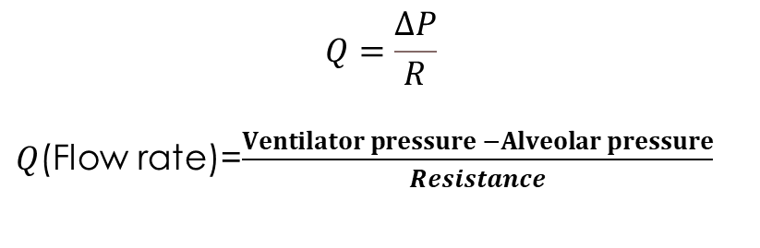
Knowledge of fluid mechanics in understanding this device
Poiseuille’s Law:
The flow of a fluid depands on pressure gradient and resistance.
Lung diseases Fluid enters into alveoli Resistance increase Flow rate decrease
$$Q=\frac{ΔP}{R}$$
$Q$(Flow rate)=$\frac{Ventilator pressure −Alveolar pressure}{Resistance}$

Slide 31
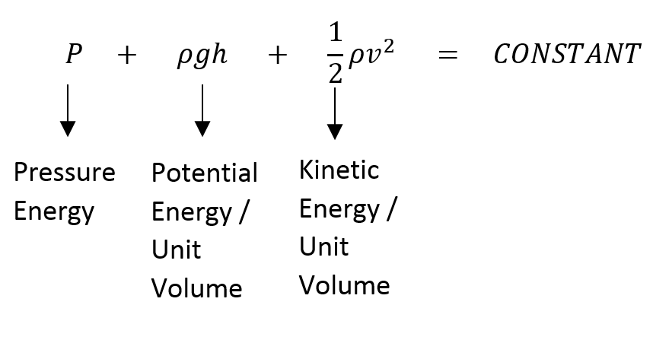
Knowledge of Fluid Mechanics Used in Mechanical Ventilator
A₁
v₁
P₁
A₂
v₂ = ?
P₂ = ?
Equation of continuity
A₁v₁ = A₂v₂
Bernoulli’s Equation

Slide 32
Risks of being on ventilation for too long
1
Ventilator induced lung injury

Slide 33
Risks of being on ventilation for too long
1
Ventilator induced lung injury
2
Muscle weakness

Slide 34
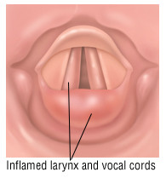
Risks of being on ventilation for too long
1
Ventilator induced lung injury
2
Muscle weakness
3
Vocal chord damage

Slide 35

Future Features
Silicone made tube
1
Endotracheal tube
Soft, bendable
Age specific tube diameter
2
AI based ventilator
3
Avoiding noise pollution

Slide 36

Any Question?

Slide 37


